Slide 1
EDAN SE-1515 PC ECG
Notes:
An electrocardiogram (ECG) is a test that records the electrical
activity of the heart.
An ECG is very useful in determining whether a person has
heart disease. If a person has chest pain or palpitations, an
ECG is helpful in determining if the heart is beating normally.

Slide 2
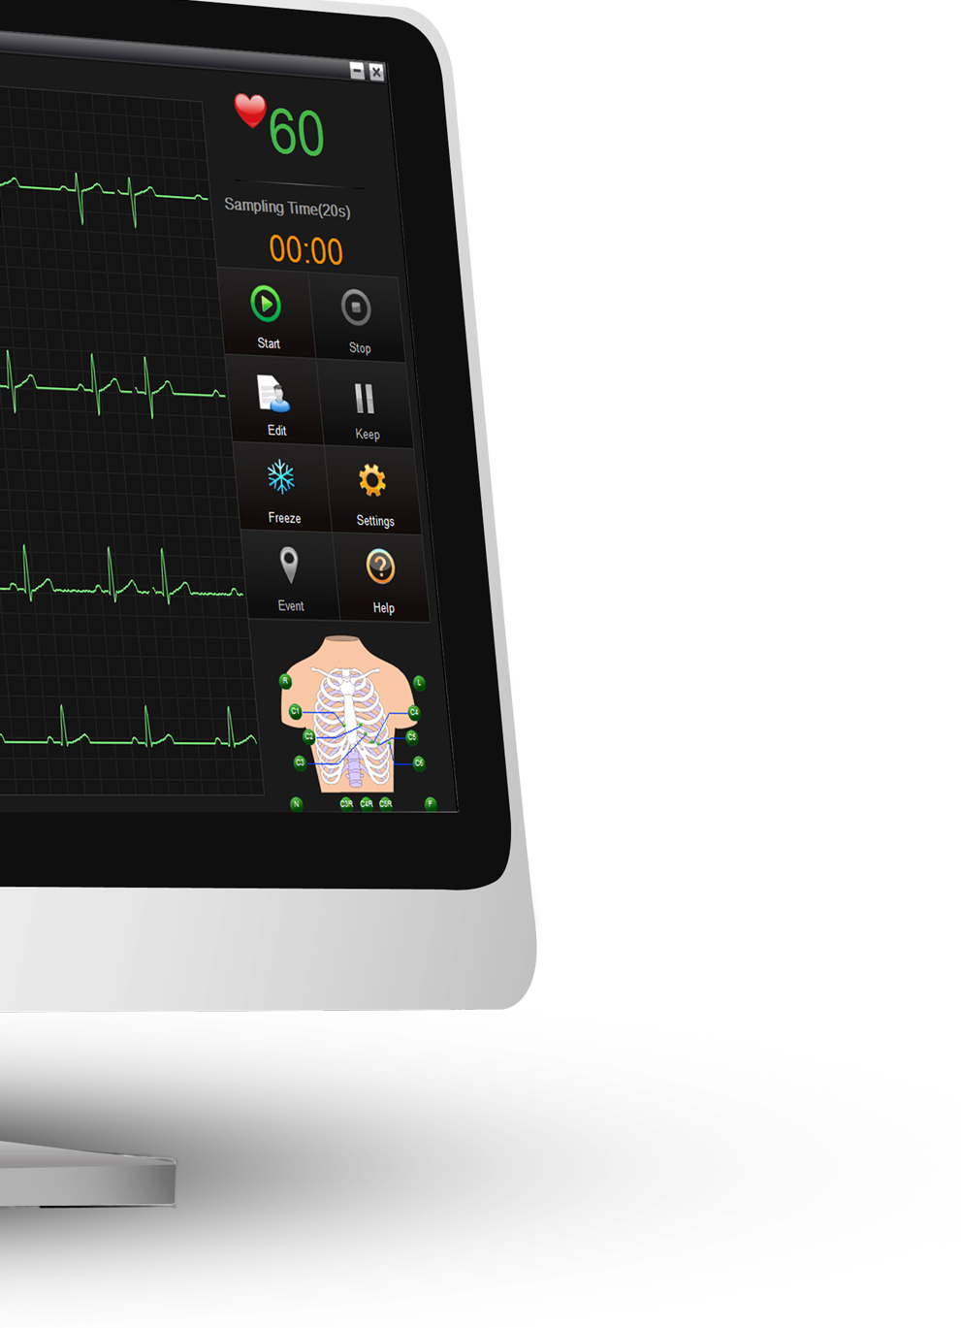
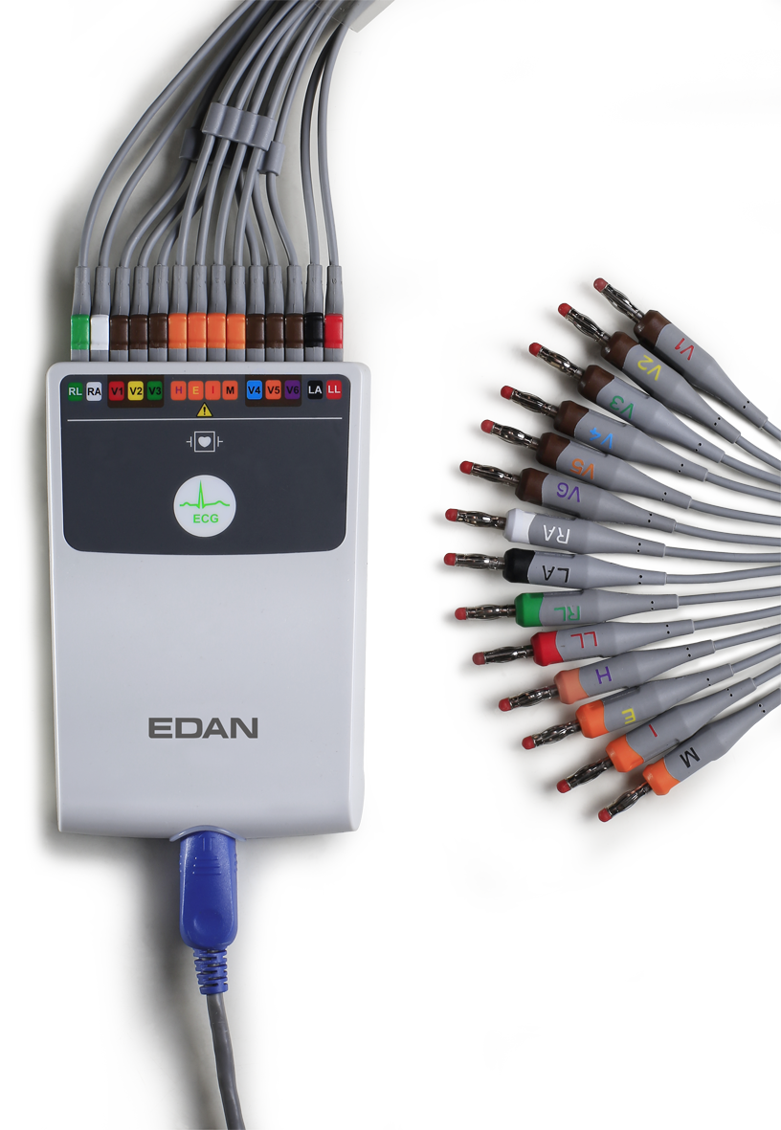

Slide 3
General Info
Clinical Background
Product Details

Slide 4
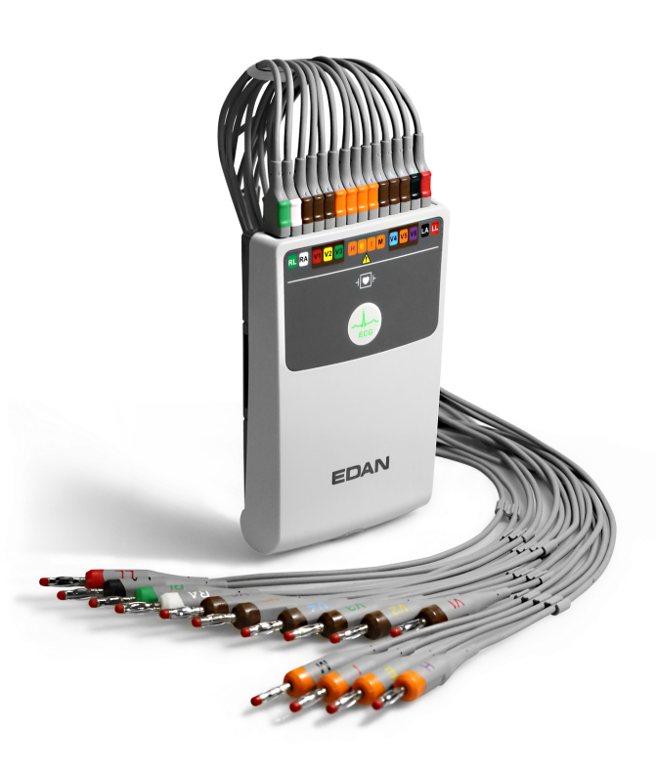
General Info
With the technology accumulation on ECG, together with years of experiences on new ECG technology projects as well as the resources from home and abroad, we are now one of the top suppliers of ECG products in global area.
High
Speed
Growth
Reputation
Technology

Slide 5
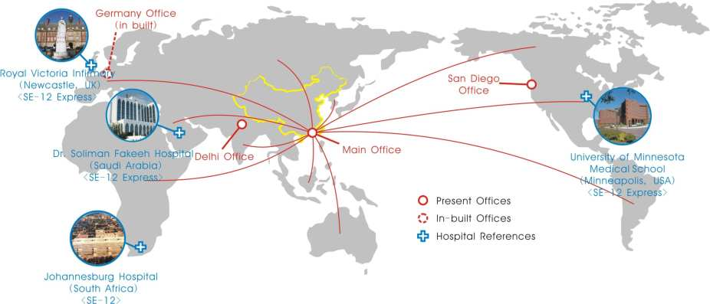
University of Minnesota Medical School is one of the TOP-3 prestigious hospitals in America, particularly in its department of Cardiology. They also developed the Minnesota Code.
The Royal Victoria Infirmary(RVI) is one of the leading UK teaching hospitals, has around 850 beds. The RVI is part of the Newcastle-upon-Tyne Hospitals NHS Trust which has around two thousand beds.
DSFH is presently considered one of the most distinguished hospitals in the Middle East, and is visited by over 500,000 patients every year.

Slide 6
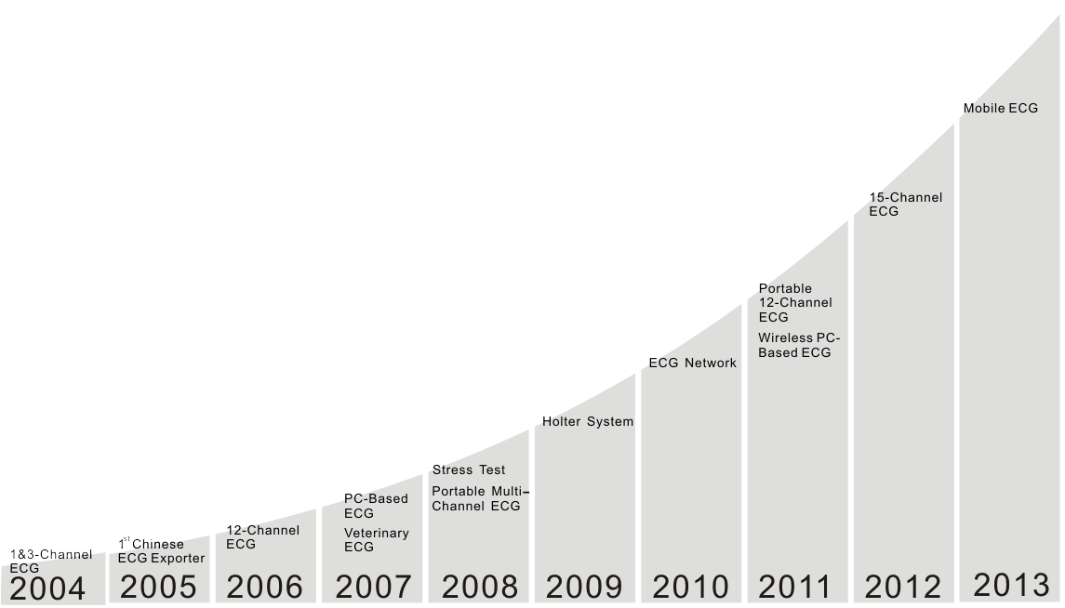
1st in China, dominating the Chinese alternative care Market
1st CSE, AHA, MIT database certified Interpretation
Release
20000+ Units sold per year

Slide 7
Clinical Background
General Info
Product Details

Slide 8
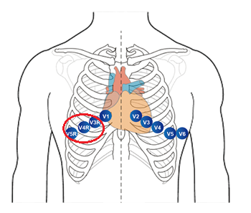
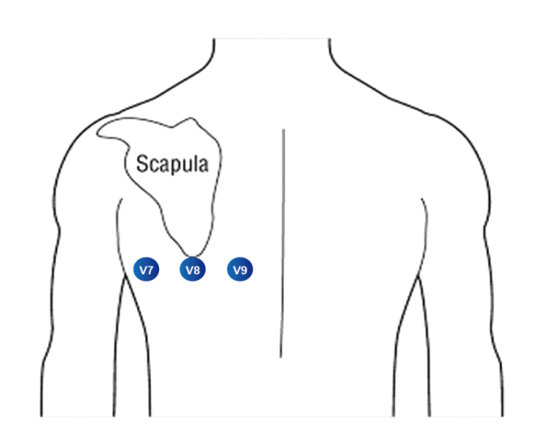
Clinical Background
What is 15/16-lead ECG?
Areas of the heart that are not well visualized by the six chest leads include the wall of the right ventricle and the posterior wall of the left ventricle. A 15-lead ECG , which includes the standard 12 leads plus right chest leads (V3R, V4R, V5R) or posterior leads (V7, V8, V9), increases the chance of detecting myocardial infarctions (MI).
Right Side Chest Leads
Posterior Leads

Slide 9
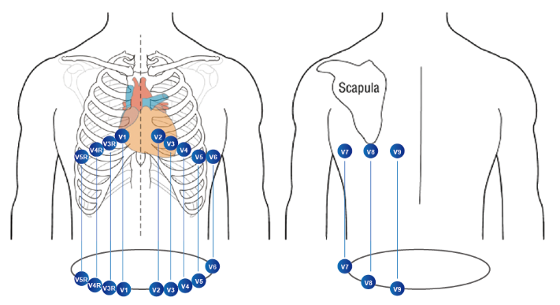
Clinical Background
Why do we need 15/16-lead ECG?
Clinicians use 15-lead ECG to confirm myocardial infarctions (MI), in patients suspected of having a blockage in the heart or an arrhythmia, an irregular heartbeat. ECGs help doctors confirm the MI and administer treatment quickly, preventing as little tissue death as possible.
To confirm myocardial infarctions (MI)
To prevent sudden death

Slide 10
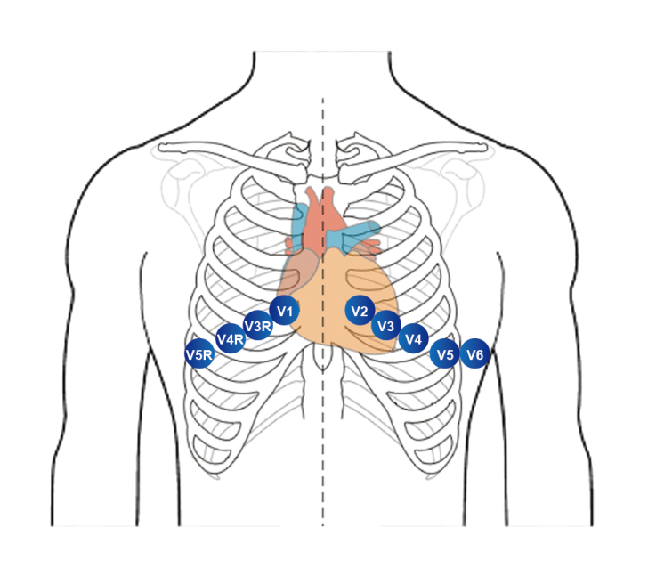
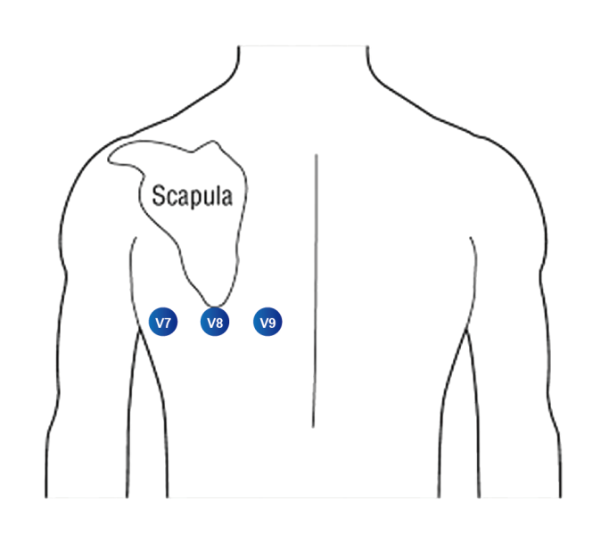
Clinical Background
How to place the electrodes?
V3R---Half way between V2R and V4R
V4R---Right side 5th intercostal space mid clavicular line
V5R---Same horizontal line as V4R on right anterior axillary line
V7---Same horizontal line as V4R on the posterior axillary line
V8---Same horizontal line as V4R, mid subscapular line
V9---Same horizontal line as V4R, left paraspinal border

Slide 11
Product Details
General Info
Clinical Background

Slide 12
List of Contents
Overview
Tech Specs
Software functions
Data management

Slide 13
Overview

Slide 14
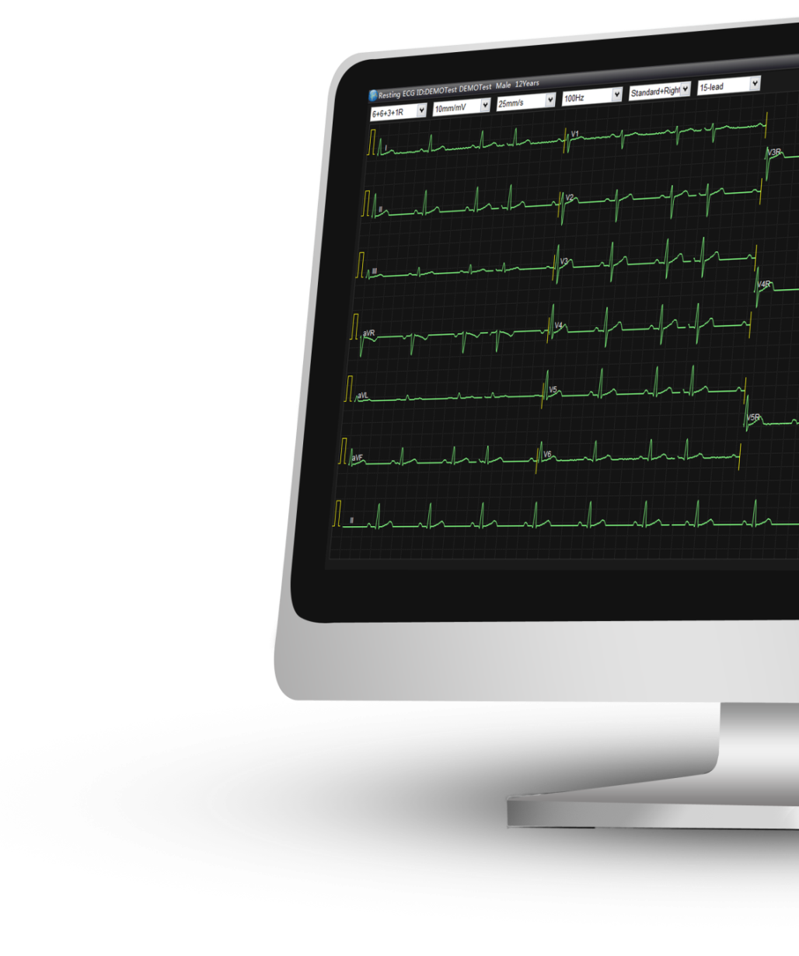
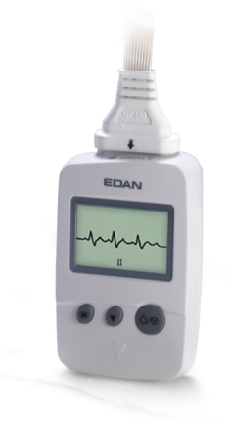
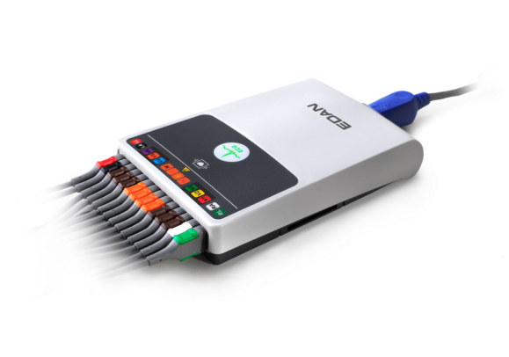
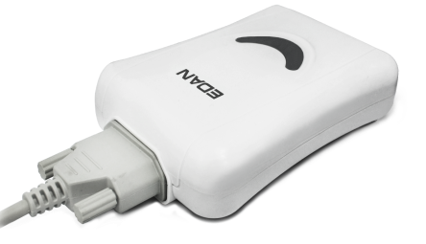
Product Details
Overview
SE-1515 PC ECG consists of PC software and one sampling box.
The software is compatible with WINDOWS 8, 7 and XP,
And the configurable sampling boxes are:
DE15 (support 15/16-lead wired sampling)
Perfect for 12/15/16-lead resting tests
DX12 (support 12-lead wireless sampling)
Ideal for 12-lead stress tests
DP12 (support 12-lead wired sampling)
Cost-effective for 12-lead resting tests
DP12
DX12
DE 15

Slide 15
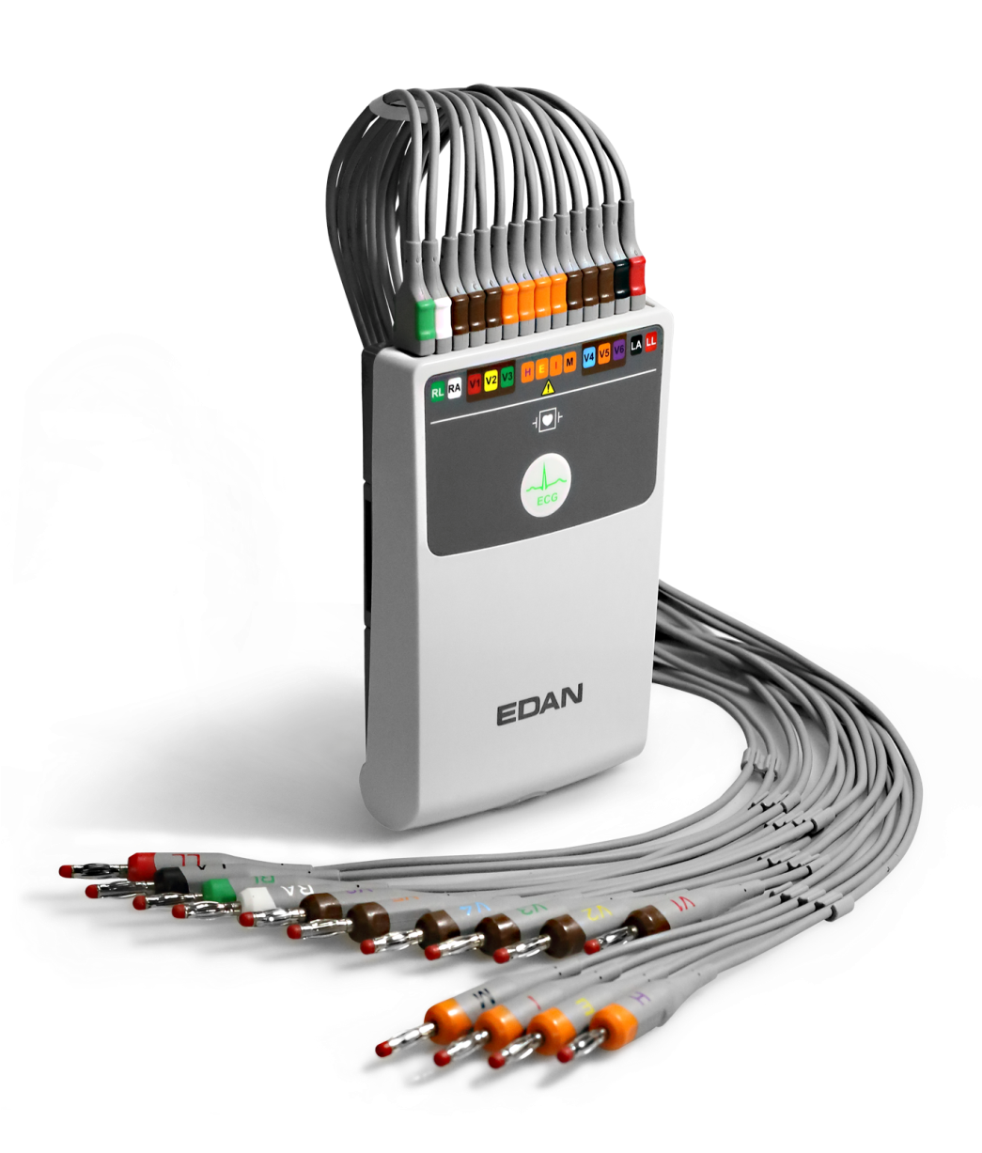
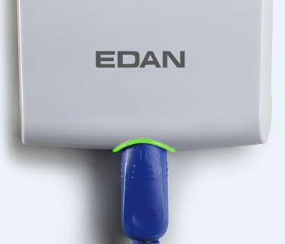
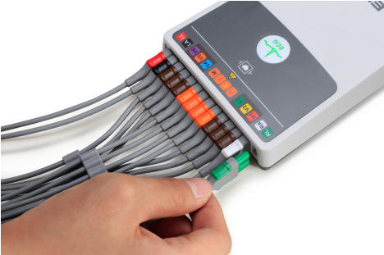
Product Details
Newly-designed DE 15 Sampling Box
User-friendly Design:
Separated lead wires
Color-coded leads
ECG signal quality indicator
One-touch Button

Slide 16
Tech Specs

Slide 17
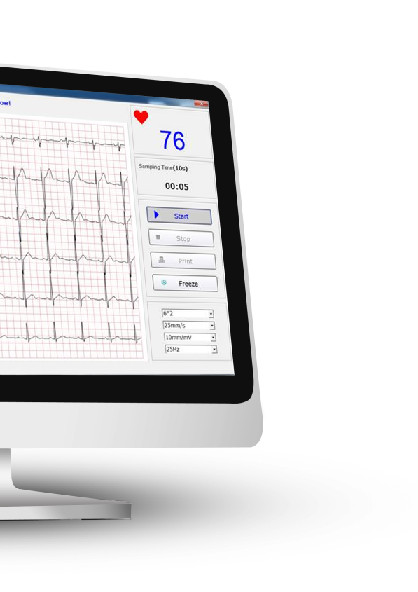
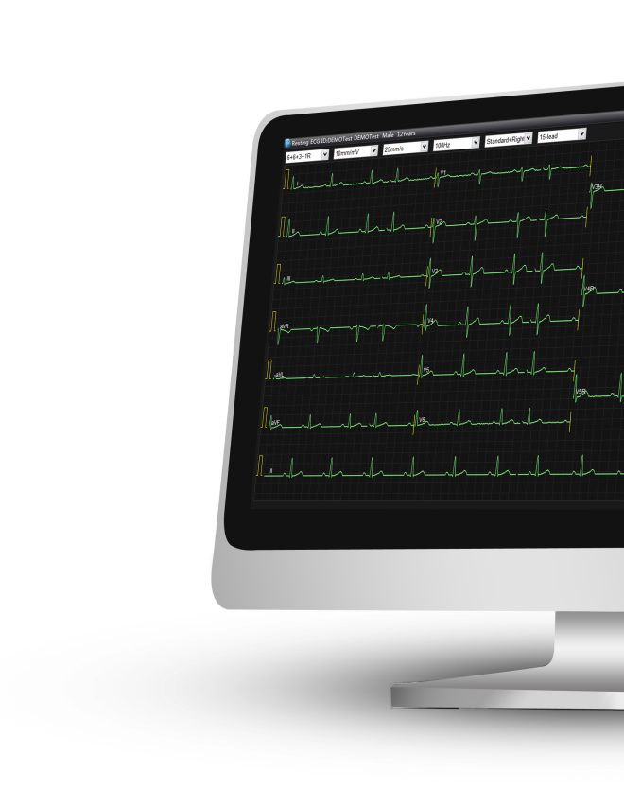
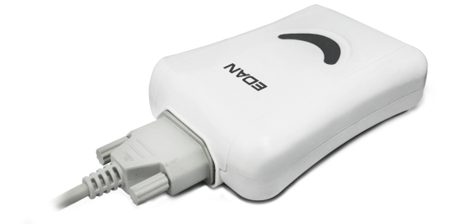
Product Details
Enhanced Tech Specs
 | SE-1010 (DP12) | SE-1515 (DE15)
Sampling Rate: | 1,000Hz | 16,000Hz
CMRR: | 115dB | 140dB
Bandwidth: | 0.05 – 150Hz | 0.01-300Hz
Input Impedance: | ≥50 MΩ | ≥100MΩ

Slide 18
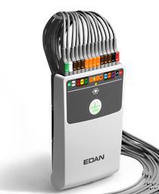
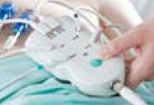
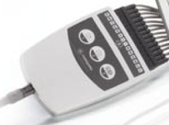
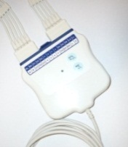
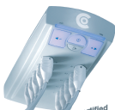
Product Details
Enhanced Tech Specs
 | EDAN | Philips | GE | Mortara | Custo Med
 | SE-1515 | TC70 | Cardiosoft | WAM | TFL-0011
Image
Sampling Rate | 16,000HZ | 8000Hz | 4000Hz | 10,000Hz, upgraded to 40,000Hz | 1000Hz
CMRR | ≥140dB | N/A | >140 dB | >100 dB | N/A
Frenquency response | 0.01-300Hz | 0.05Hz ~ 150Hz | 0.01 to 150 Hz | 0.05-250Hz | 0.05-500Hz
AD Convertor | 24 bit | 12 bit | N/A | 20 bit | 24 bit
Input Impedance | ≥100MΩ | ≥100MΩ | >10MΩ |  | >50MΩ

Slide 19
Product Details
Benefit of Enhanced Tech Specs
High sampling rate (16,000Hz) and Input Impedance (≥100MΩ) allow you to have more accurate ECG waveforms.
High Common Mode Rejection Ratio (140dB) helps encounter signal noise to the greatest extent.
Wide bandwidth (0.01 - 300Hz) perfectly fulfills the requirement for pediatric case, as a minimum high frequency response of 250Hz is recommended by American Heart Association (AHA).

Slide 20
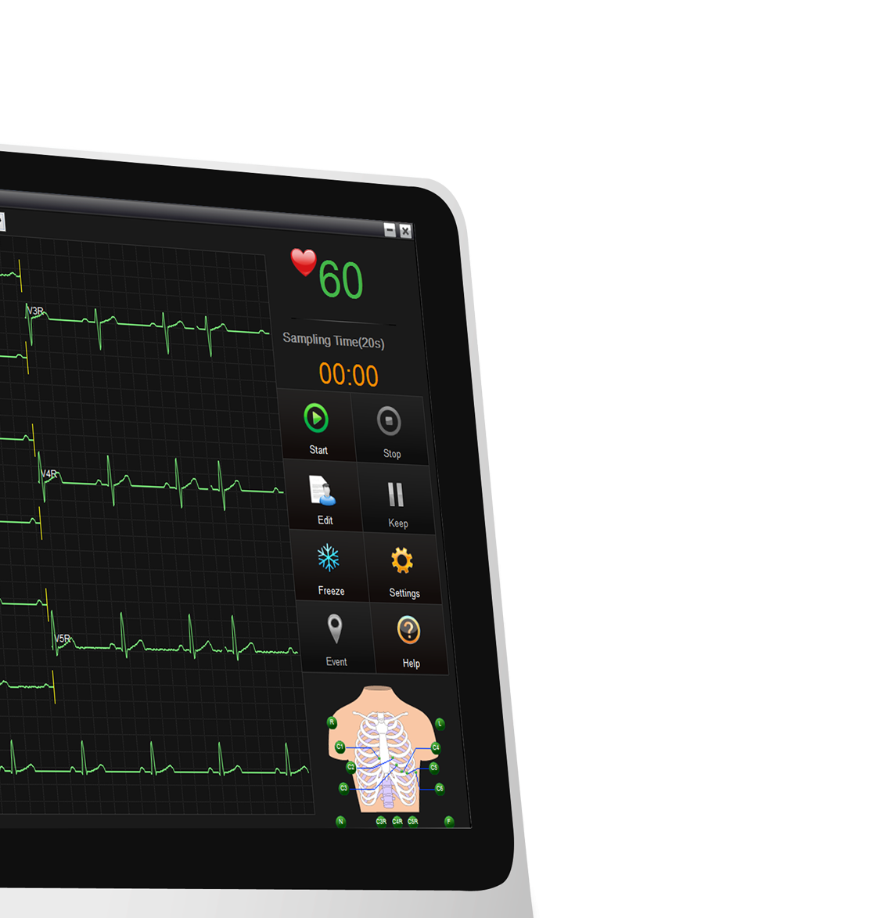
Software Functions

Slide 21
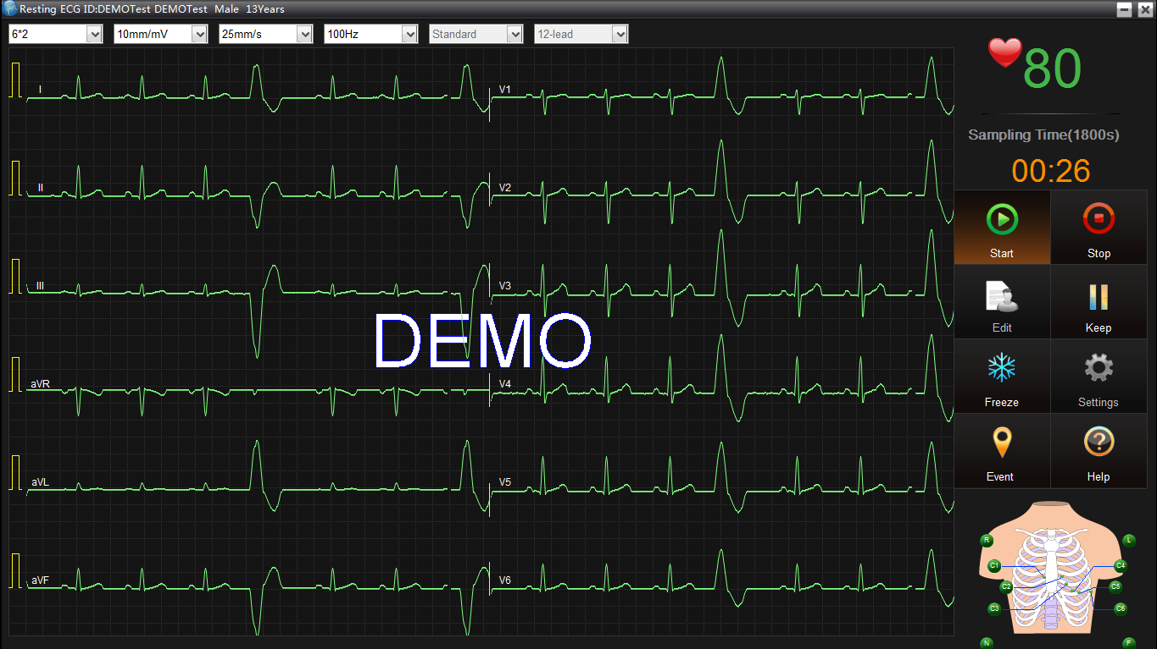
Product Details
Long sampling time
A maximum sampling time of 1800 seconds is supported for resting tests.

Slide 22
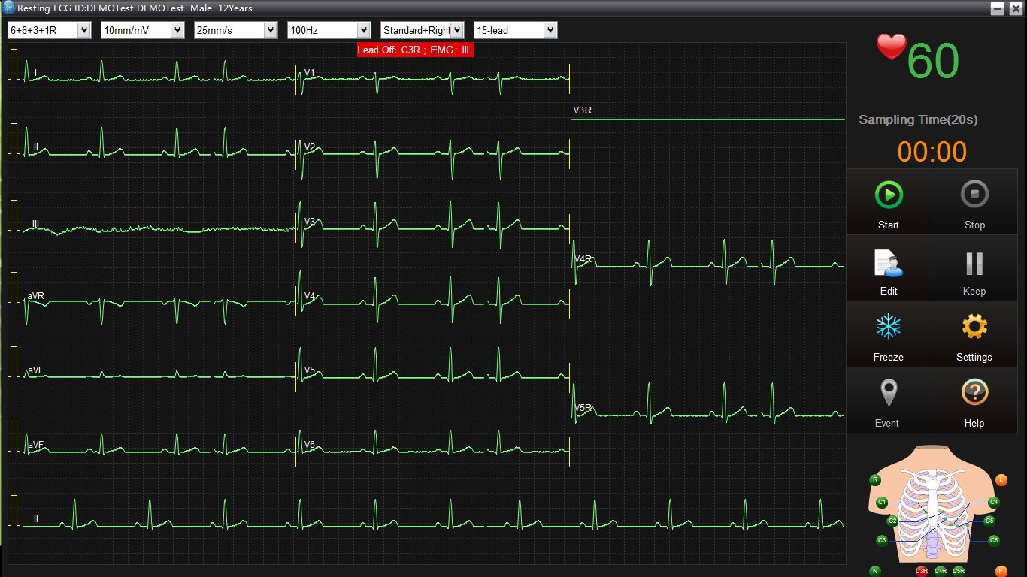
Product Details
ECG Signal Quality Indicator
Green: ECG quality is good
Orange: ECG quality is poor
Red: ECG quality is missing
(C3R is lead off, while lead III has EMG artifact)
Visual alarm of ECG quality status is also displayed on the interface.

Slide 23
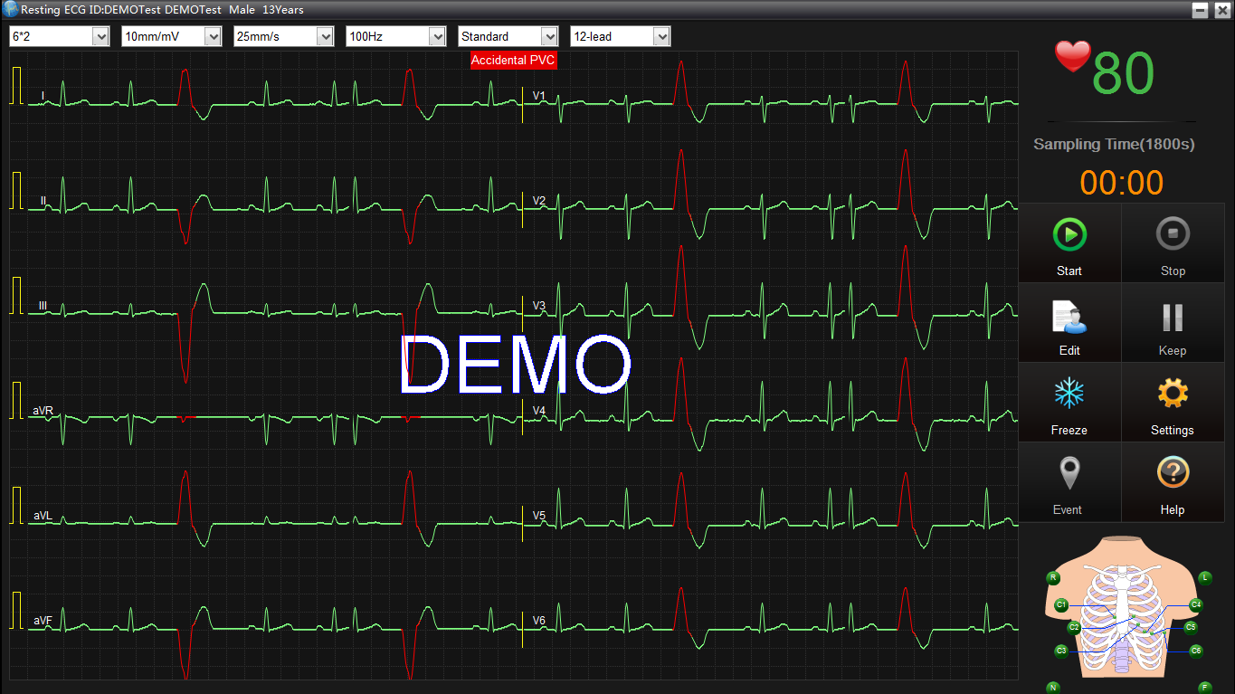
Product Details
Automatic Arrhythmia Detection
Arrhythmia can be detected and highlighted as red automatically.

Slide 24
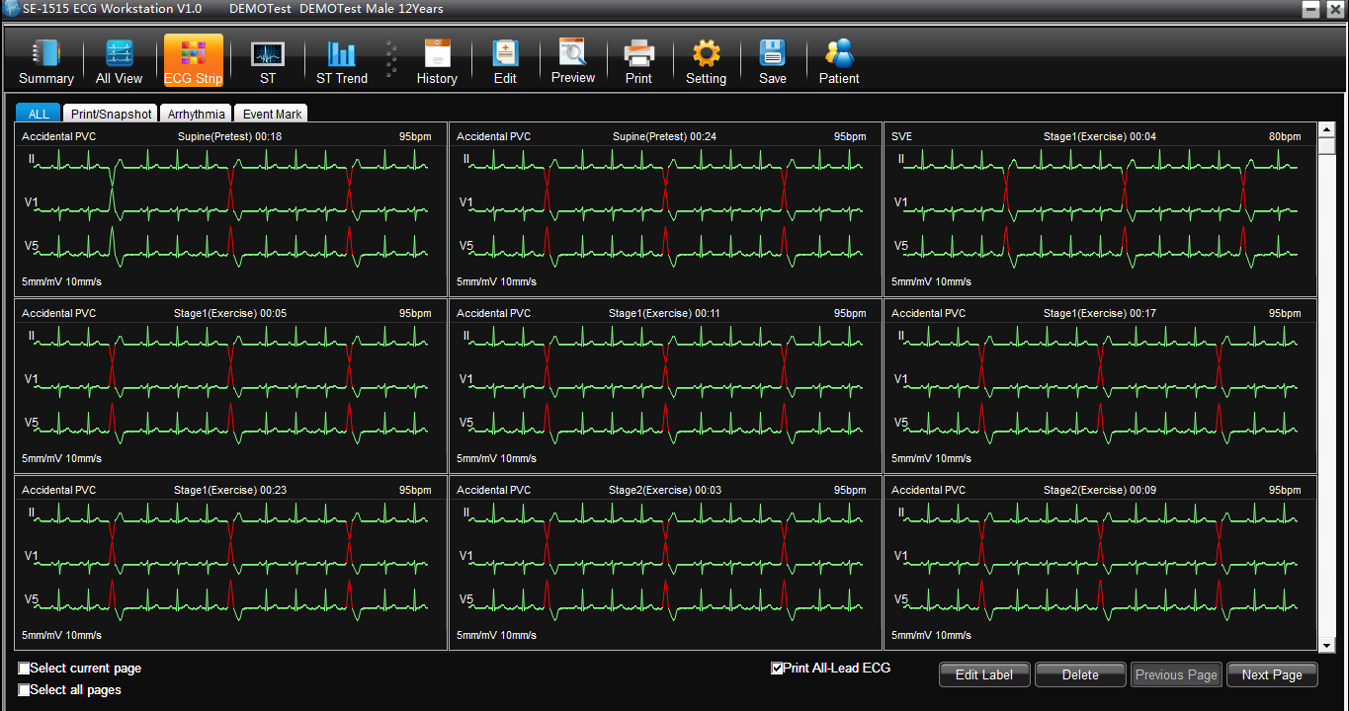
Product Details
Auto Events Save
Events include:
Arrhythmia
Parts of waveforms with doctors’ notes
Parts of waveforms which are
printed during the tests
Parts of waveforms which are snapshot during diagnosis
Auto 12-lead ECG reports in each stage

Slide 25
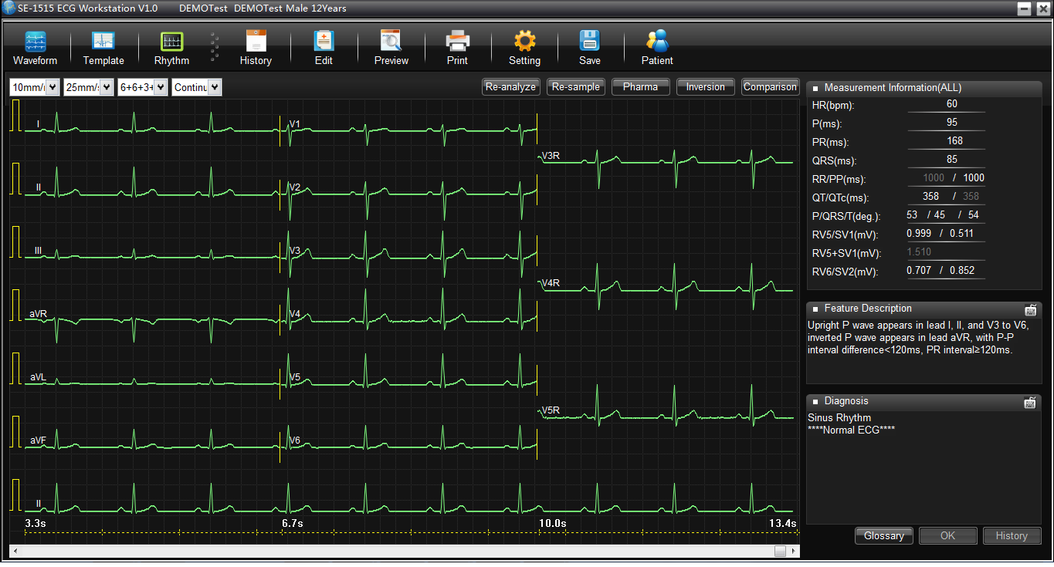
Product Details
Powerful Functionality
Proof for Diagnosis
Proof for diagnosis or feature description is added in diagnosis which enables more
convincing report.

Slide 26
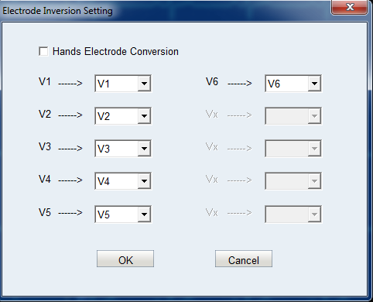
Product Details
Powerful Functionality
Lead Reversal
You can reverse the leads in wrong placement directly on the software.

Slide 27
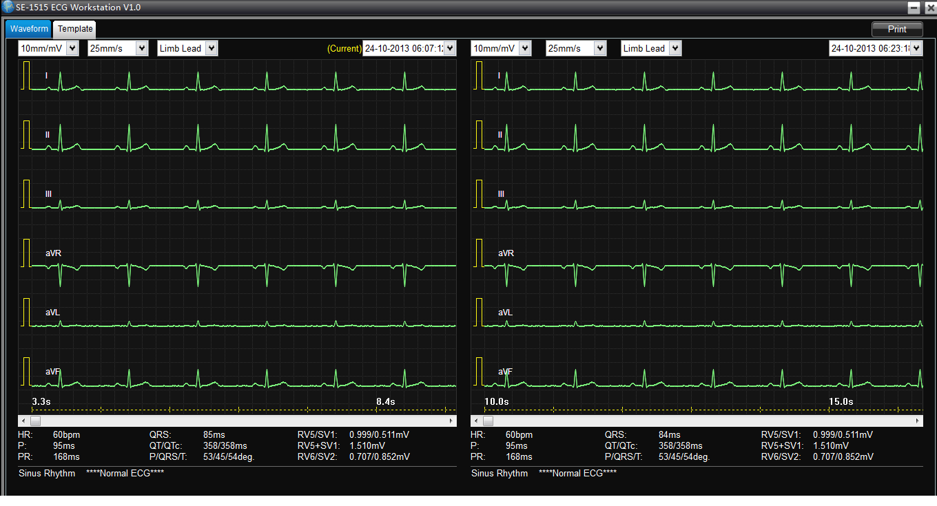
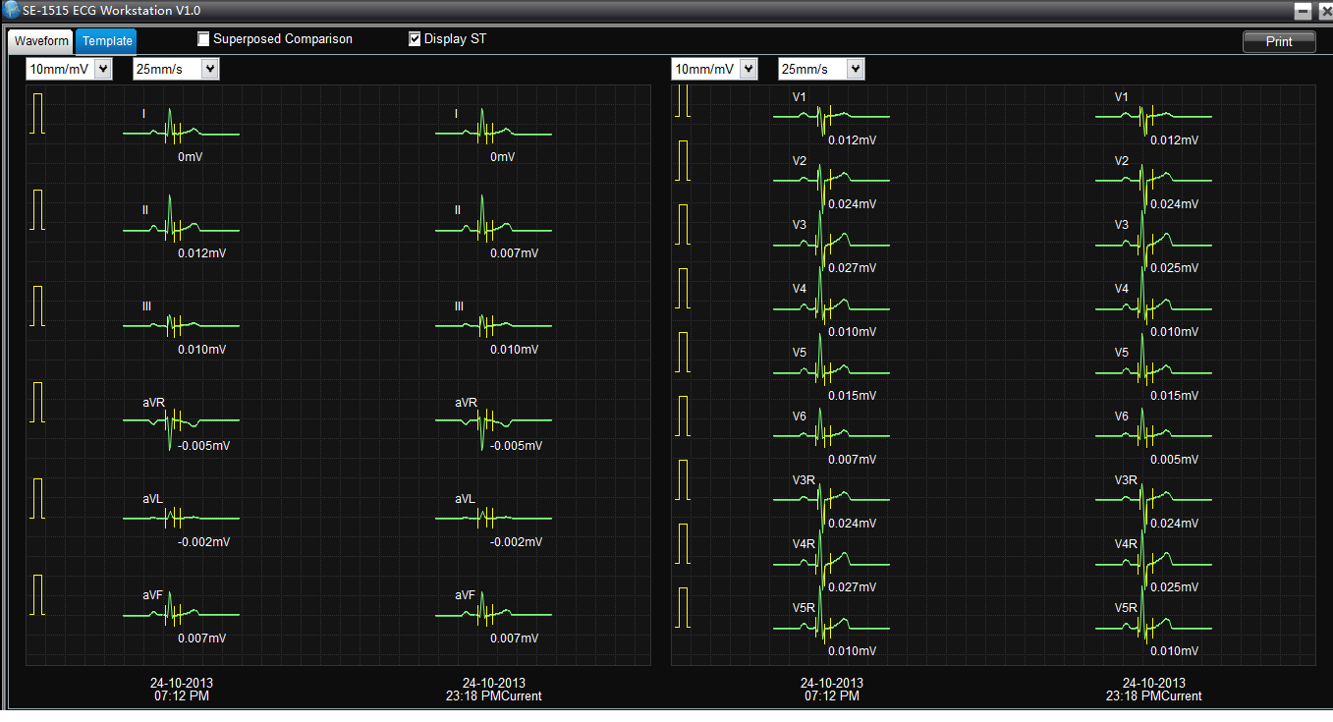
Product Details
Reports Comparison
Reports Comparison
Templates Comparison

Slide 28
Product Details
Stress ECG
Improved filter technology ensures clear waveforms even though patients are in noisy environments
METs, Double Product(DP), Duke Score and FAI are evaluated during a test.
Optimized functions ensure the stress test more professional.
Manual stress test
Event mark
Cool down and restart treadmill during the test

Slide 29
Product Details
Other Improvements
Optimized UI
Manual measurements and diagnosis
Editable ECG reports

Slide 30
Data Management

Slide 31
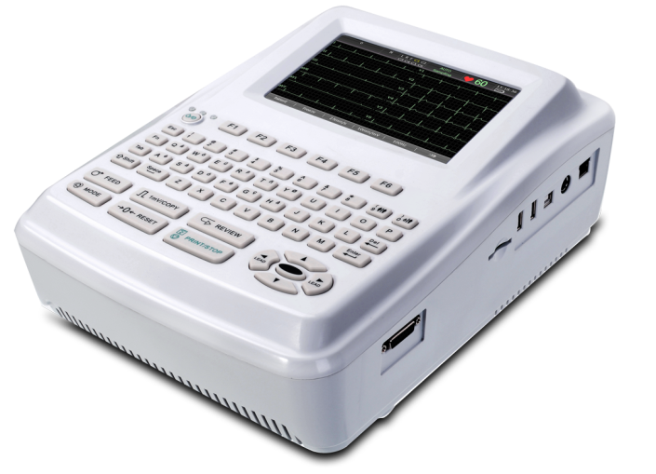
Product Details
Data Management
Store, Review, Edit, Print and Transmission for ECG data
Support multi-formats report:
XML/SCP/DICOM/PDF/JPG/BMP
Bi-directional communication with ECG machines
Patient Info
ECG Report

Slide 32
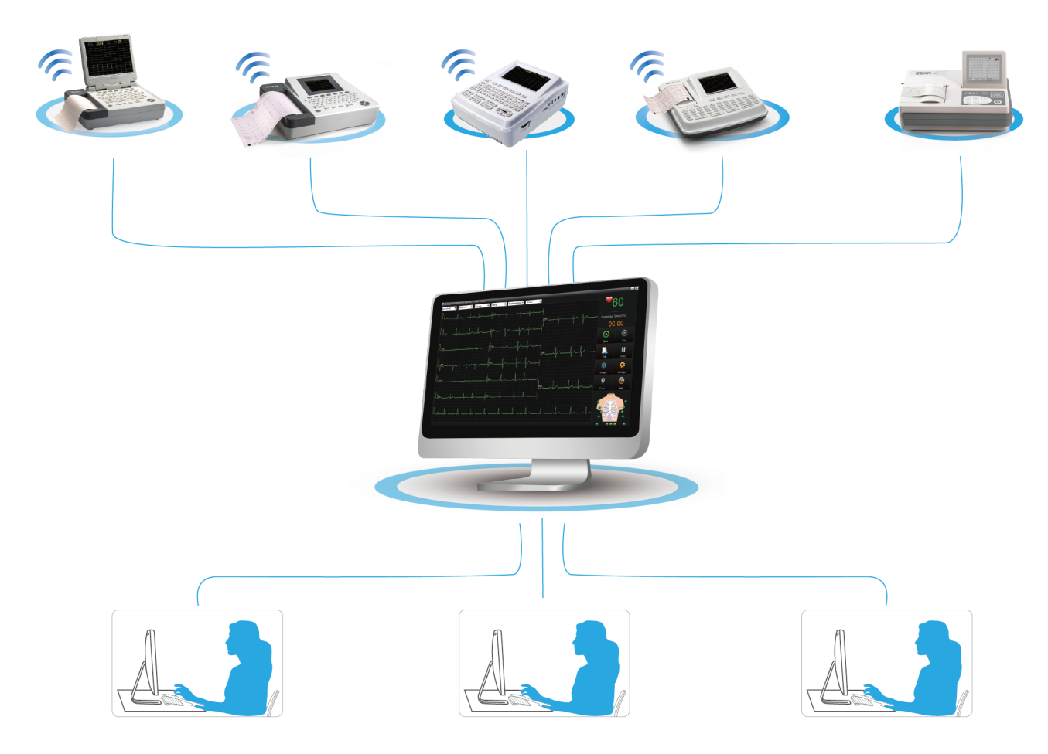
Product Introduction
Networking
One SE-1515 software can work as a server to share its database, and the other
SE-1515 as clients are allowed to access the database, and make diagnosis
on different sites.

Slide 33
Highlights

Slide 34
Highlights
Separated leadwires
Color-coded leads
ECG signal quality indicator
One-touch Button
The sampling rate is as high as 16,000Hz
AD converter is 24 bit
Common Mode Rejection Ratio is over 140dB
The bandwidth (frequency response) is 0.01-300Hz
Input impedance is over 100MΩ
Automatic Arrhythmia Detection
ECG Signal Quality Indicator
Automatic Events Save
Lead Reversal
Proof for Diagnosis
Reports Comparison
Optimized Stress Test
Data Management Solution

Slide 35
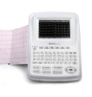
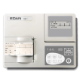
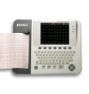
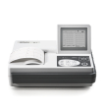
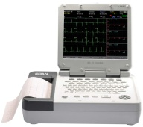
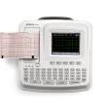
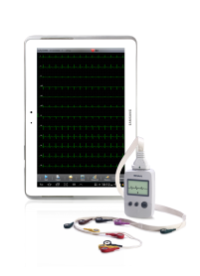
Thank you

