Slide 2

Ambulatory Blood
Pressure Monitor
SA-10
Edan Instruments, Inc.
www.edan.com
info@edan.com

Slide 3
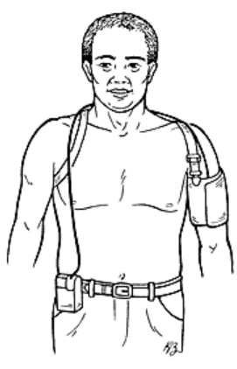
What is ABPM?
ABPM (Ambulatory blood pressure monitoring) is a portable device for recording the blood pressure periodically (usually at 15 or 30 minutes intervals) throughout 24 hours, during routine daily activities as well as sleeping.
Advantage of ABPM
Continuously Measurements
Long-time Period
Non-invasive testing
Don’t affect patient’s routine life
Riskless and painless

Slide 4
Why is ambulatory blood pressure monitoring used?
Ambulatory BP monitoring provides additional information about how changes in your BP may correlate with your daily activities and sleep patterns. Guidelines for blood pressure management from the American Heart Association and American College of Cardiology now strongly recommend confirming a diagnosis of hypertension with ambulatory BP monitoring.
It’s a useful way to detect:
White coat hypertension
Masked hypertension
Sustained hypertension
Pregnant women with hypertension.
People with “borderline” hypertension.
Difficulty controlling BP with medication.
BP changes due to other drugs.
Changes in prescription medications that may impact BP.
Fainting episodes or hypotension (low BP).
Notes:
For most people systolic BP decreases about 10% to 20% during sleep. However, for some people BP might not drop during sleep. It may even rise.
White coat hypertension: Some people who don’t take blood pressure-lowering drugs (antihypertensive drugs) have elevated readings when their BP is taken in a healthcare setting. This is known as “white coat hypertension.” White coat hypertension can result in misclassification of patients whose BP is actually normal. White coat hypertension has been seen in 10% to 30% of patients with elevated BP readings. Current guidelines don’t recommend treatment when ambulatory monitoring shows readings within the normal range outside the doctor’s office. However, ongoing research suggests this condition may still indicate a blood pressure problem, so you and your provider should keep an eye on it.
Masked hypertension: This condition occurs when your BP reading is normal at the doctor’s office, but elevated when you’re at home. It may occur in up to 20% of untreated people. This condition has similar risk to sustained hypertension, and should be treated with antihypertensive medications
Sustained hypertension: This refers to BP readings that are elevated whether you’re in the doctor’s office or at home. This condition has been linked to an increased likelihood of heart and kidney damage.

Slide 5
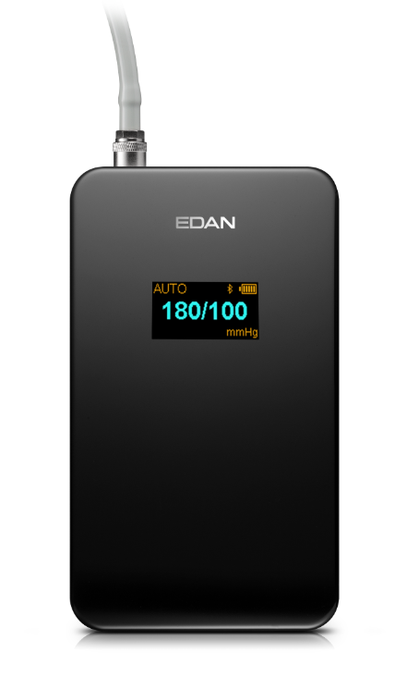
SA-10
Blood Pressure Monitor

Slide 6
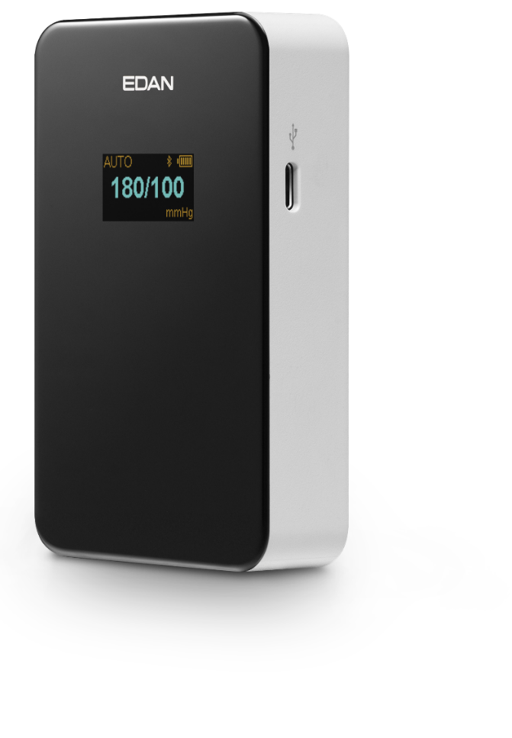
Compact & Ergonomics Design
Lightweight Design
The lightweight (160g) and pocket size makes EDAN ABPM easy to carried without bothering patient’s daily routine. With the smooth surface and the streamline modeling, it fits into the palm perfectly.
Pocket Size
Smooth edges
Compact size
Lightweight (160g)

Slide 7
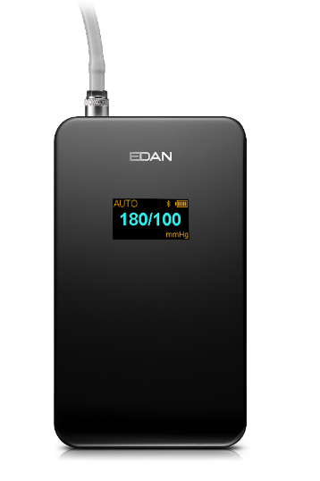

Patient friendly
0.96-inch OLED screen. Distinct to read.
Less than 45dB noise during measuring. Don’t disturb the patient.
＜45dB
＜45dB
Low Noise

Slide 8
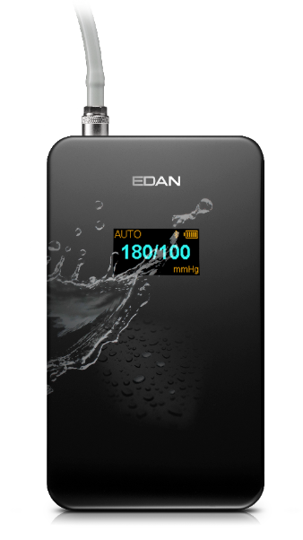
Durability
Water and dust proof
SA-10 reaches IP22 protection grade, intending to prevent unexpected damages from water and dust, which maximizes patients’ freedom in their daily life. The waterproof capability facilitates the cleaning and disinfection procedure as well.
IP22
Water & Dust Proof

Slide 9
Accuracy
Anti-movement Algorithm
EDAN has over 20 years of experience in NIBP measuring product, therefore the patent algorithm can significantly reduce the interference from patient movement and ensure the accurate testing.

Slide 10
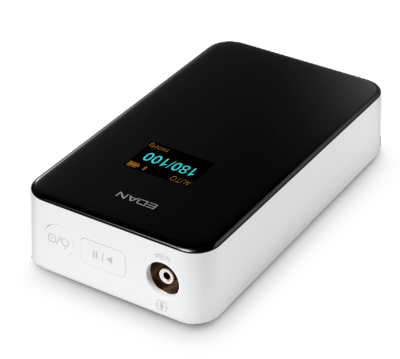
Safety
Overtime and Overpressure Protection
SA-10 is capable of overtime and overpressure protection to avoid the accidental hurt during long-time blood pressure monitoring.
Protective Redundancy
SA-10 has dual sensors and valves to protect the patient’s safety. It works normally even when one sensor or valve is defective. Never bring any harm to the patient.
Protection
Notes:
超时和过压保护：限制时间120s，限制压力297±3mmHg；

Slide 11
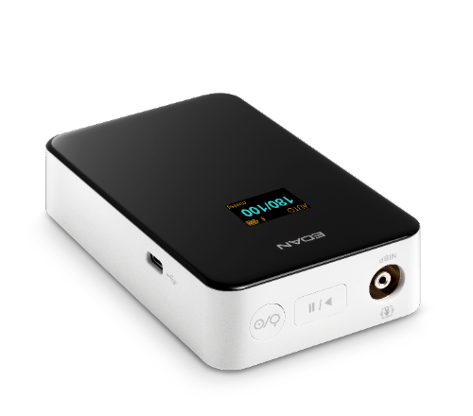

Reliability
Long Life Span
Type-C port: ＞10000 times
Pump: 160,000 times
Valve: 1,000,000 times
Non-volatile Memory
SA-10 saves the data automatically while power failure. And it reverses the working status when power recovers. Never need to worry about the data lost due to power issue.
AAMI Validation
Meets the latest the AAMI standard (ANSI AAMI ISO 81060-2:2019).
Notes:
通讯接口(Type-C)：不会像Micro USB 存在插反损坏接口的情况，每天插拔，2次，一年365天，相当于可以用13年
泵的寿命：按照每天测量48次计算，可使用9.13年~
断电后数据保存：患者监测过程中电量不足自动关机，已监测数据可自动保存，患者自行更换电池后，无需任何操作，即可继续监测；

Slide 12
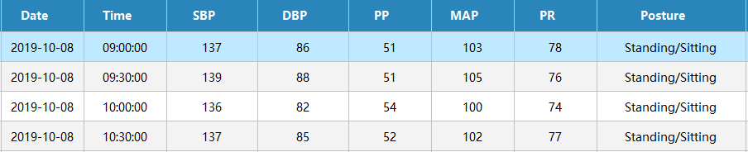
Smart
Body Posture Detecting
SA-10 can detect the patient’s body posture during monitoring. It helps the doctor to diagnose the blood pressure changes and identify the OH (Orthostatic Hypotension).
Auto Re-testing
Automatically retest when one measurement fails, to ensure the successful implementation of the testing plan.
Auto Data Refreshing
When the patient’s data was loaded and a new monitoring starts, the old data in the recorder will be overlain automatically to avoid any confusion.
Notes:
如何辅助医生对血压数值的准确性进行评估：
例：24h监测过程中，白天大部分是120/70左右的血压，突然有一个血压值，98/50，医生会有疑问，这个是个人的血压变化，还是测量的异常值？
此时，可根据体位来进行判断，如果是躺着的，很大可能体位的变化引起的，如果是剧烈运动，很大可能是测量过程中的干扰导致的异常值，可以予以排除~
体位性低血压：又称直立性低血压，快速站立时，血压明显下降的情况；

Slide 13
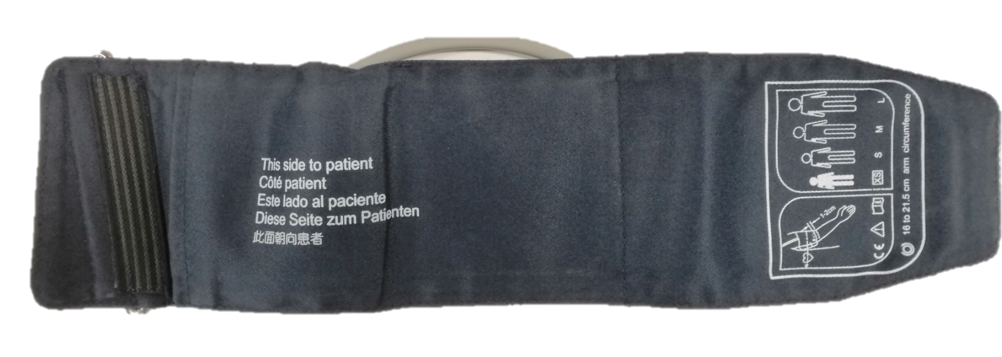
Comfort
Extrusion Prevention
Fan-shaped
Reduces the extrusion while BP testing
Ensures perfect fitting with the arm
Loose Proof
Comfortable Material
Prevents loose during long term monitoring
Woven cloth material that soft and permeable
Intelligent Pressurization
With the help of self-adaptive measuring technology, the patient feels more comfortable during BP testing.
Intelligent
Pressurization

Slide 14

Low Power Consumption
Power
Saving
Long Working Time
SA-10 is designed with low power consumption, which improves the efficiency and saves the cost.
Two Alkaline batteries | Two Ni-MH batteries (Rechargeable, 2500mAh)
Used for two patients. Easy to replace and improves the efficiency. | Used for three patients. Rechargeable and saves the cost.
* Working time tested under standard criteria and settings. Different criteria and settings may affect the testing results.
Notes:
测试方案：150/100mmHg的血压，15/30min的监测方案，
一般临床应用：30/60min 的监测方案；
竞品情况：一般（Suntech，伟伦，百慧，星脉等）都是两节碱性电池，测一个病人；A&D TM2430 三节碱性电池，可支持测量2-3个病人；

Slide 15

Event Marker
Event Marker
During the monitoring, patients may encounter some events like feeling dizzy or short of breath, which may lead to blood pressure fluctuation. In such cases, by long-pressing the “Start/Stop” button for 3 seconds, an Event Marker will be recorded and distinguished through the software analysis. Those records give doctors reference to make precise diagnosis.

Slide 16
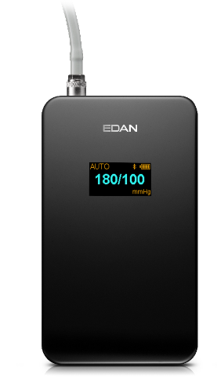
Fast Startup
Fast Power On
The device powers on automatically once batteries are installed, to improve the efficiency.
USB Power On
SA-10 can be powered on by USB cable even the batteries are exhausted, to let the user easier to load the data.
Built-in Testing Plan
With built-in testing plan, SA-10 is able to begin monitoring without initiation via PC.

Slide 17
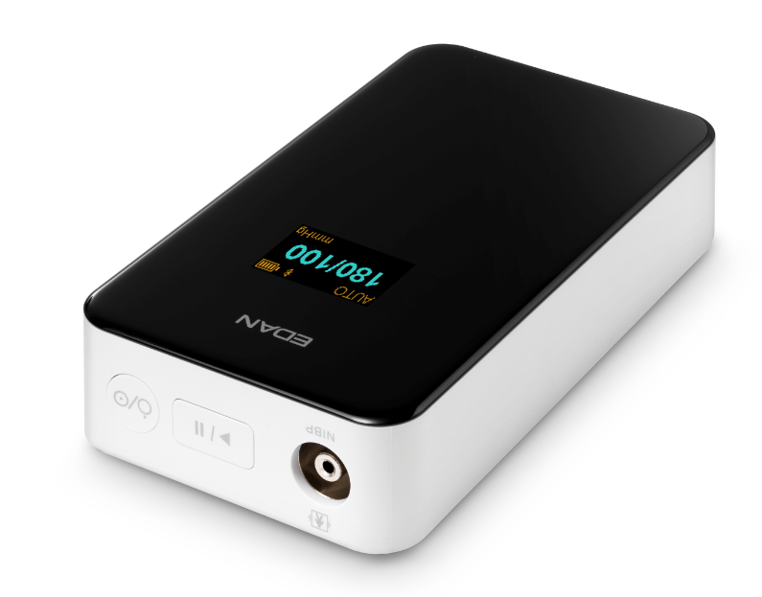
Highlights of SA-10
Blood Pressure Monitor
Power
Saving
AAMI
Standard
Pocket Size
＜45dB
M
160/90
Low Noise
Intelligent
Pressurization
Event Marker
IP22
Water & Dust Proof
Protection

Slide 18
Smart ABPM View
Notes:
工作流清晰易懂
功能丰富
配置灵活，操作便捷

Slide 19
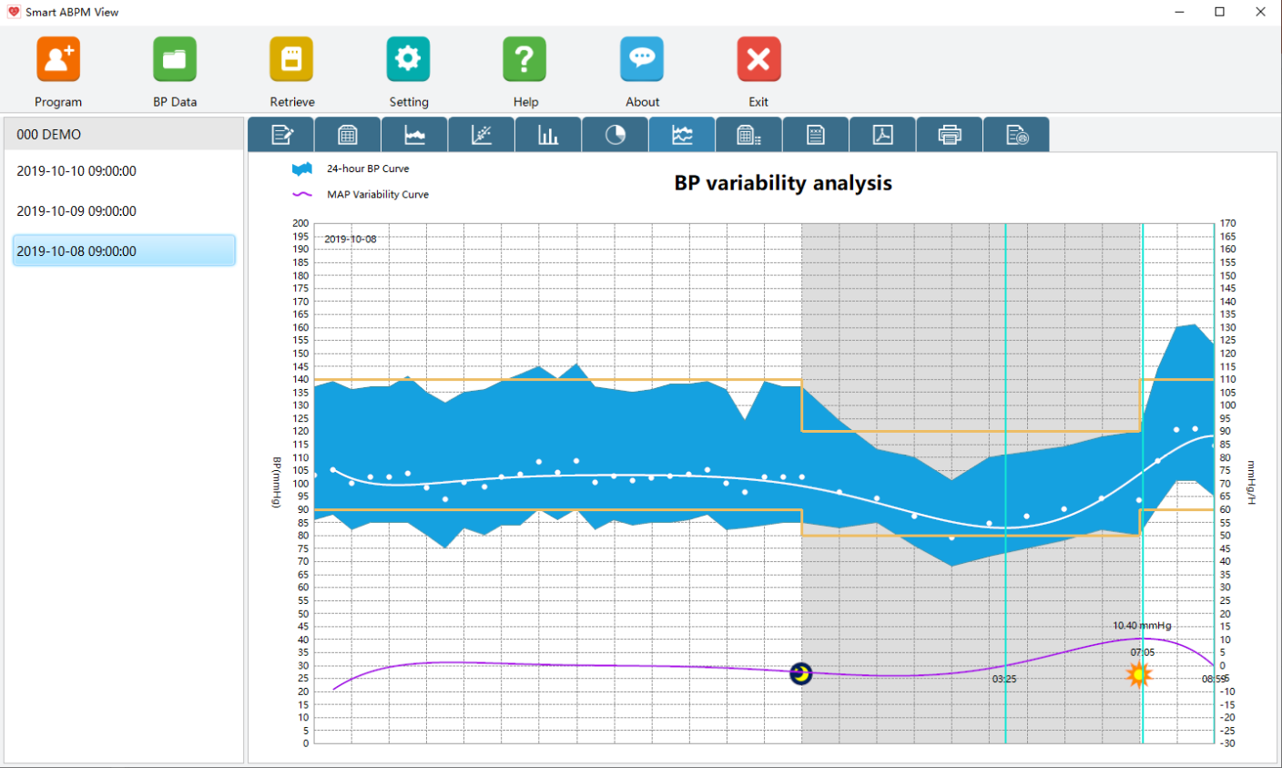
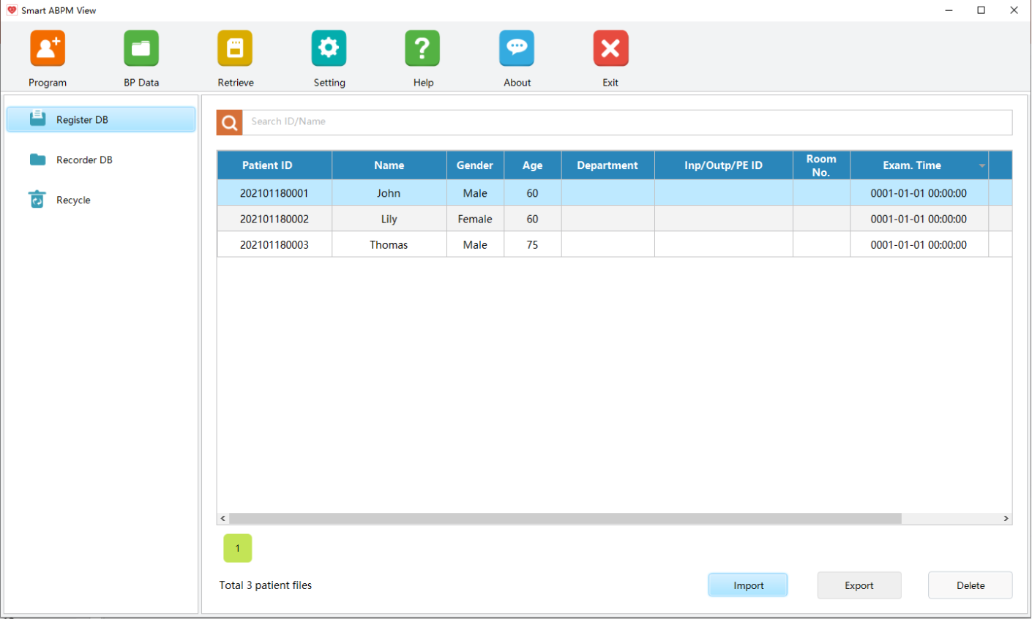
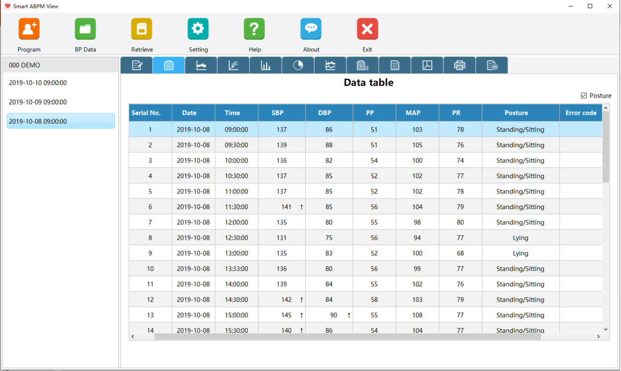
Flat UI
Intuitive User’s Interface
Most of the functions can be get in three steps. Just learn and play!

Slide 20
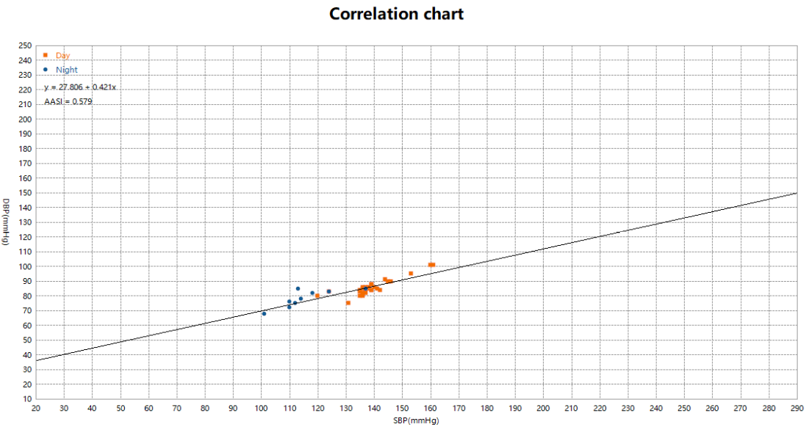
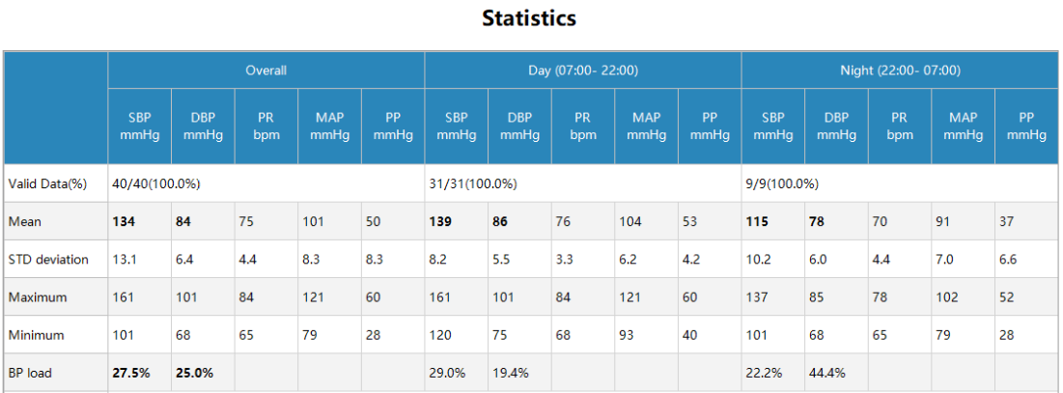
Comprehensive Tools
Ambulatory Arterial Stiffness Index (AASI)
AASI indicates the elastic function of the artery.
Pulse Pressure (PP)
With the normal range of 30-50mmHg, the elevation of PP is an independent risk factor for cardiovascular events.
Notes:
动态动脉硬化指数: 基于舒张压与收缩压的关系统计
脉压：>63mmHg作为动脉粥样硬化形成的危险界限

Slide 21
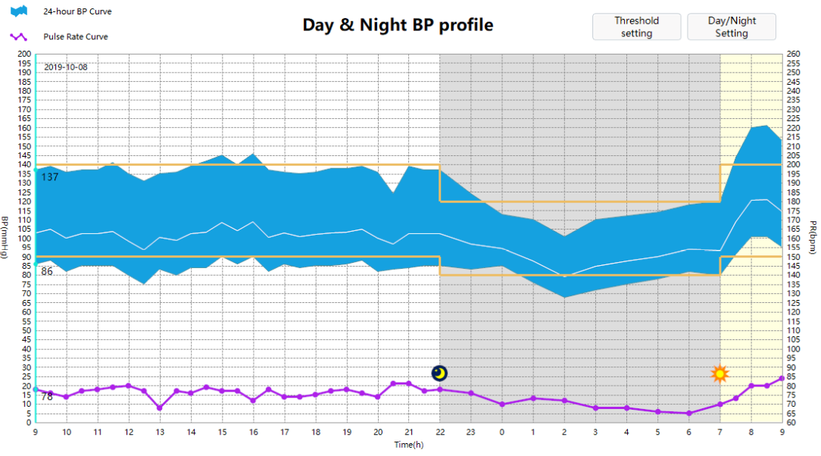
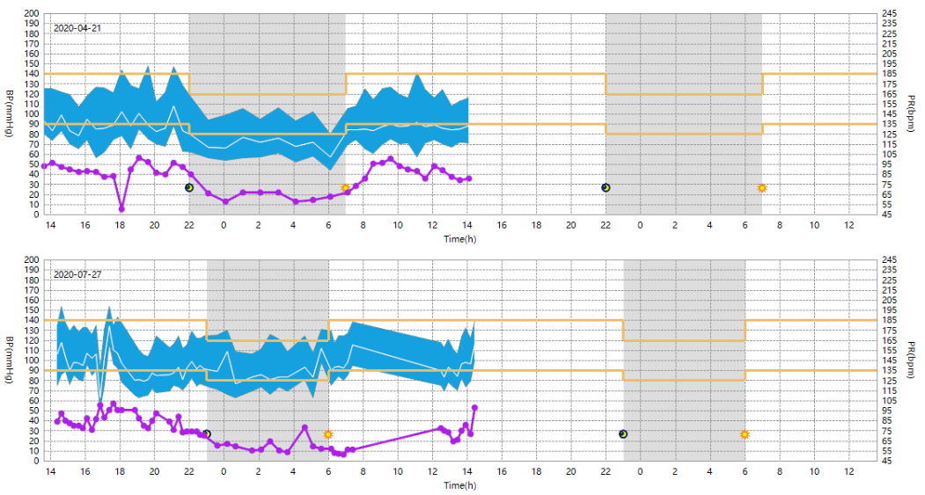
Comprehensive Tools
Day & Night BP Profile
The profile indicates the statistic of BP in the day and night. The BP evelation of morning surge will be highlighted.
BP Comparison
The patient data under the same ID can be managed together and selected for comparison.
Notes:
晨峰血压：目前，临床研究已经证实，心脏性猝死、心肌梗死、不稳定性心绞痛和出血性、缺血性脑卒中等心脑血管事件特别容易发生在清晨，与凌晨血压增高密切相关，独立于24h平均血压。与一天中其他时间相比，清晨时心脏病发作的危险度高40％，心脏猝死的危险度高29％，各型中风的危险度高49％。因此，有效控制血压晨峰，有助减少触发心脑血管事件发生。
控制好清晨血压，是防治心肌梗死、脑卒中发作的重要一环。对绝大多数患者来说，清晨血压是管控全天24小时血压的风向match标。通过监测清晨服药前血压，可以很好地判断患者的降压治疗方案是否能够真正控制24小时血压。

Slide 22
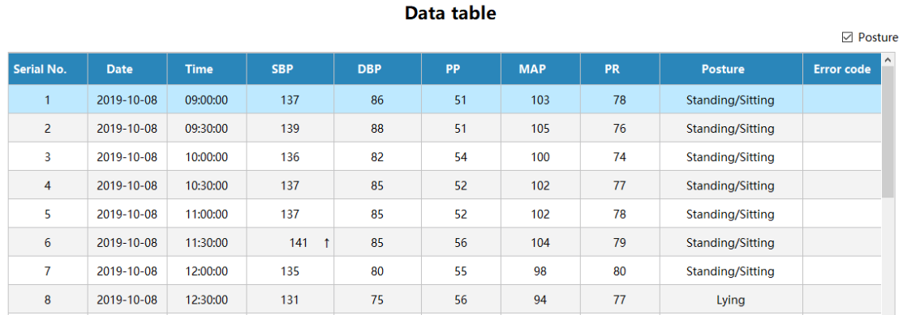
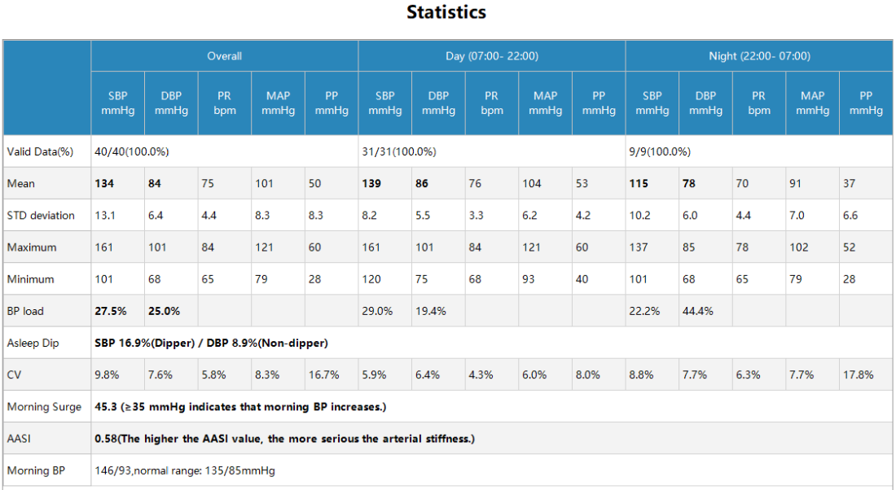
Comprehensive Tools
Data Table
The specific testing results can be remarked and printed. The threshold can be set manually for a better fitting to special patients or clinical research.
Statistics
Supports the analysis of BP load, asleep dip, CV and morning surge. The normal range is prompted for reference.
Notes:
支持血压负荷，夜间血压下降率的统计分析
支持变异系数，晨峰血压的统计分析

Slide 23
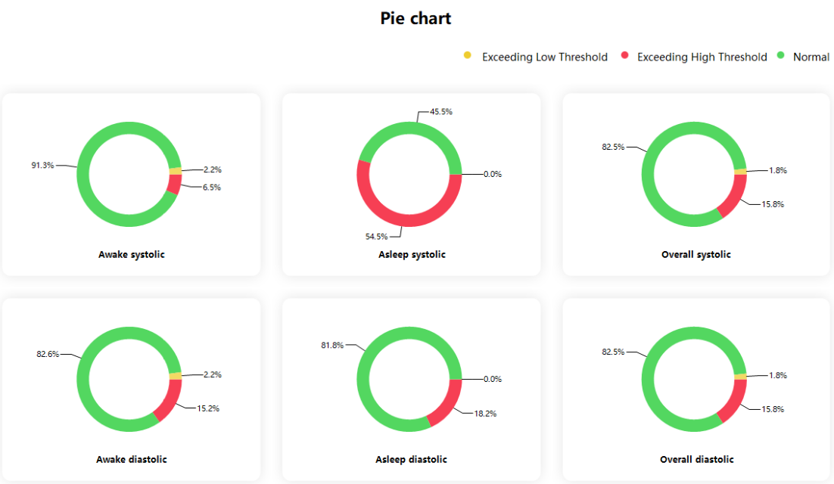
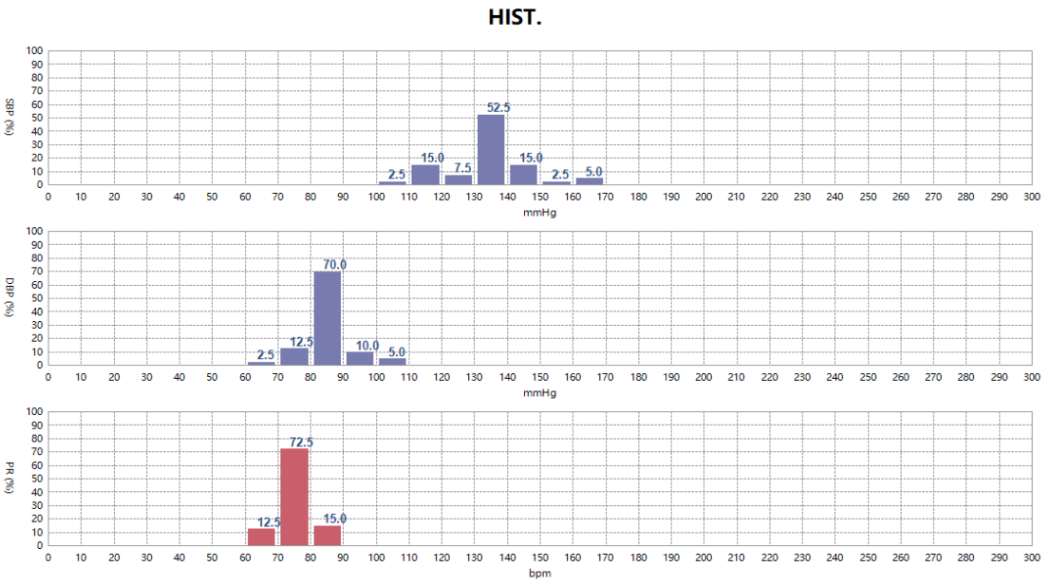
Comprehensive Tools
Pie Chart
It shows statistics of BP in day and night according to the threshold setting.
Histogram
It shows SBP, DBP and PR intuitively for easier reading.

Slide 24
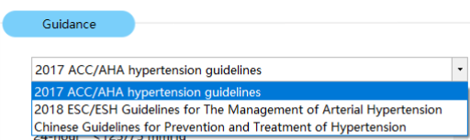
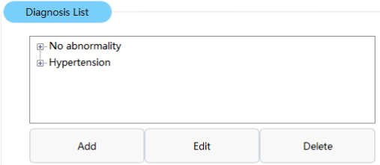
Comprehensive Tools
Various Guidance
Smart ABPM View integrates ACC/AHA and ESC/ESH guidelines which could provide fast interpretation.
Built-in Glossary
The built-in glossary helps clinicians draw conclusion effectively and efficiently.

Slide 25
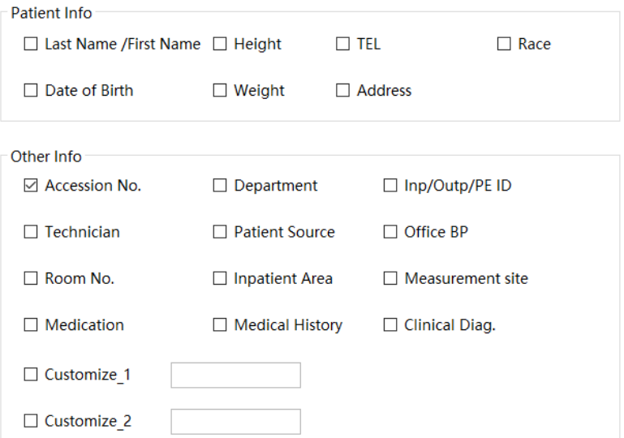
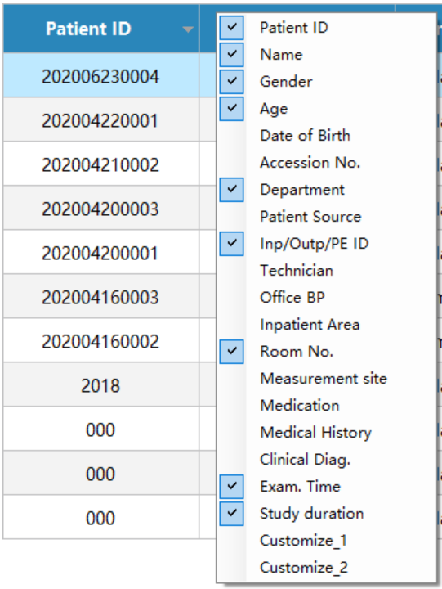
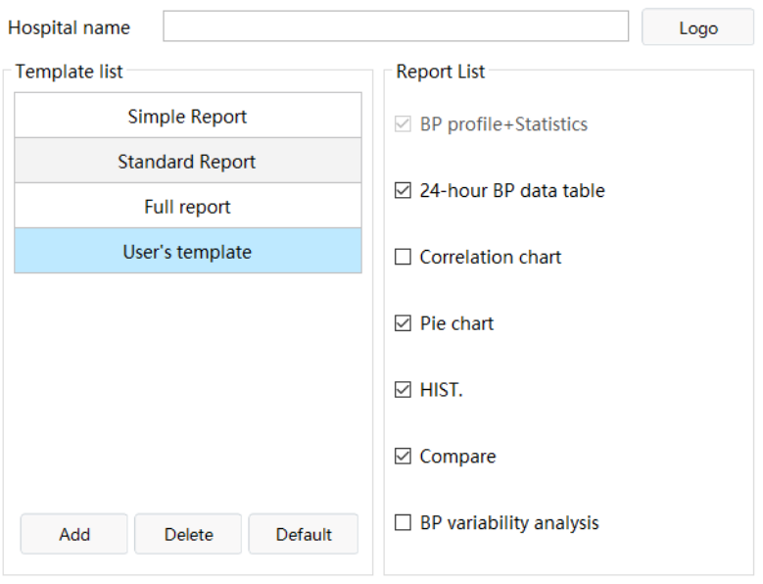
Flexible Settings
Easy to use
The patient info, report template and patient list can be customized as per the clinical needs for easier use.

Slide 26
Highlights of
Smart ABPM View
BP
Comparison
Flat UI
AASI
Pie Chart
2
1
4
Pulse
Pressure
3
Day & Night
BP Profile
Histogram
Glossary
Personalized
Signature
Build-in
Glossary

Slide 27
THANK YOU
Edan Instruments, Inc.
www.edan.com
Info@edan.com

