Slide 1
VitaScan Online Calibration
May 2015

Slide 2
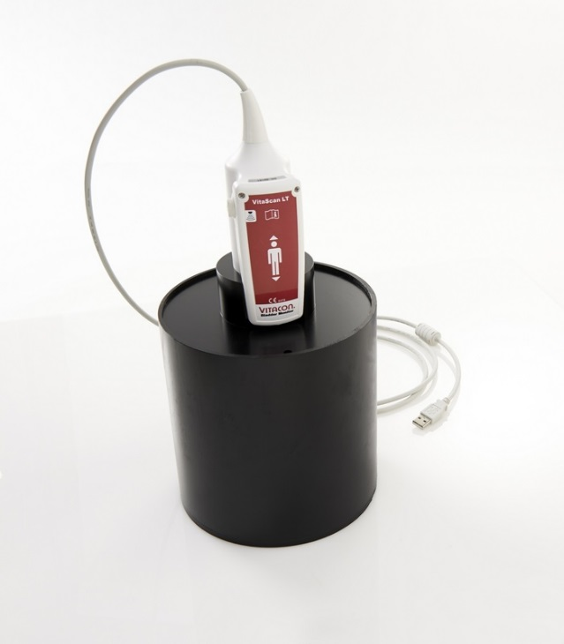
VitaScan Online Calibration
System integrity test.
Firmware update.
Field calibration.
Issue valid calibration certificate.

Slide 3
Create an user account
First time users: Create a new user account on www.vitacon.com/calibration
You will get an confirmation mail on your email when your account is approved. Click on the link in the email to verify your email-address.
Login to your account by credentials received on email: www.vitacon.com/calibration
Enter probe serial number, and generate a calibration code.
You will receive the calibration code on your email.

Slide 4
VitaScan Calibration Website

Slide 5
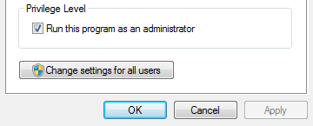
Installing Software
Download the Calibration Software from calibration website, or from www.vitacon.com/downloads
Install the software, and follow user instruction.
NOTE: After installation make sure the application is set to «Run as Administrator» . “Right click “ VitaScan Calibration icon -> properties -> compatibility.

Slide 6
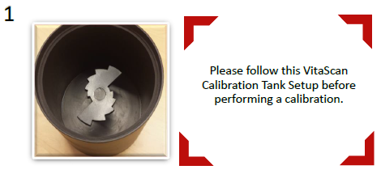
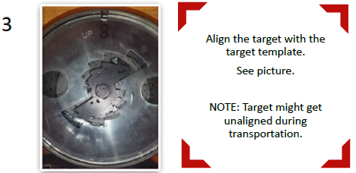
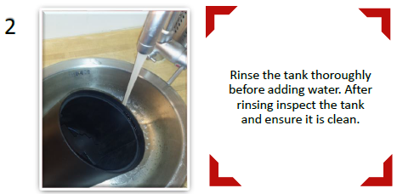
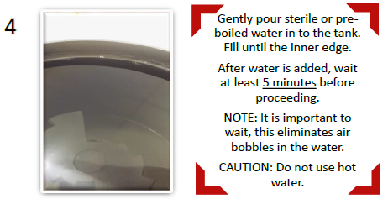
Test Tool Setup

Slide 7
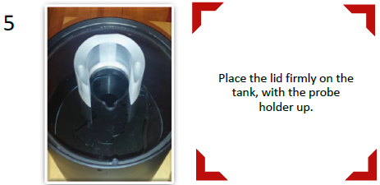
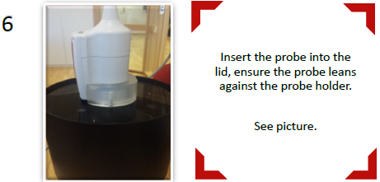
Test Tool Setup (page 2)
Reference: Calibration Test Tool Setup.pdf

Slide 8
VitaScan Online Calibration Software
Use the login credentials you received on email to login to the application

Slide 9
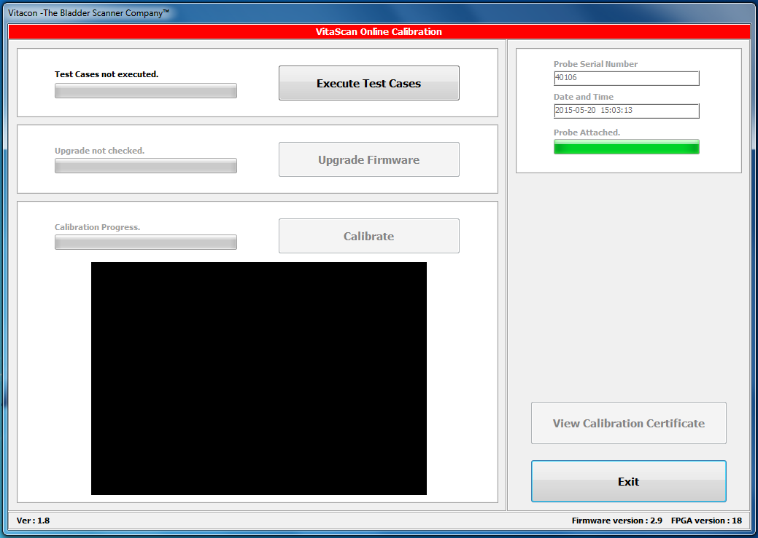
VitaScan Online Calibration Software performs 3 actions:
Execute Test Cases: System integrity test. Memory test and PCB verification.
Upgrade Firmware: Checks and uploads newest firmware.
Calibrate: Performs 24 scans, calculates alignment, skew and volume calibration.

Slide 10
Calibration completed

Slide 11
Calibration certificate

